Slide 1

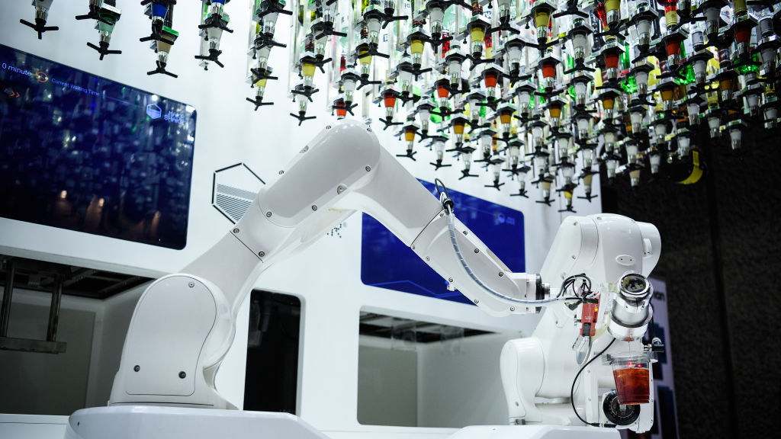
UR10e Robot Cocktailer Maker
Sebastian Schroder
Jiahui Huang
Leroy Heta

Slide 2
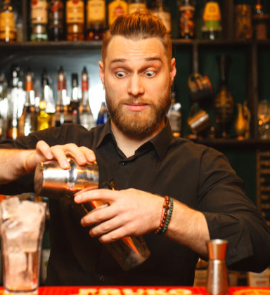
Aren’t you sick of Bartenders not making your drink right everytime?

Slide 3
Look no Further than the amazing robot cocktail maker

Slide 4
Robot Modelling

Slide 5
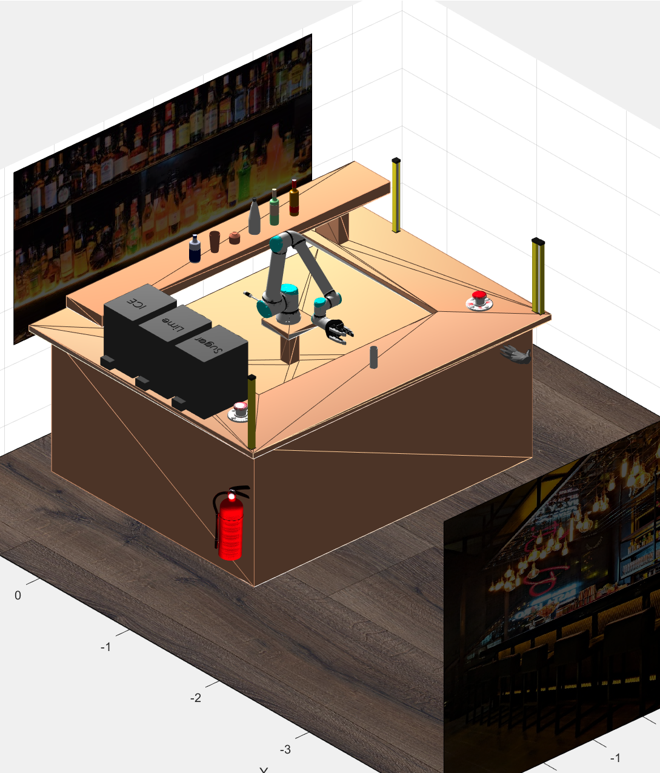
Planning and Safety
Fire hazards secured w/ fire extinguisher
Functional e-stop button
Functional light curtains placed on bar
Bar designed to exceed working radius of arm

Slide 6
GUI in Operation
Add video with gui

Slide 7
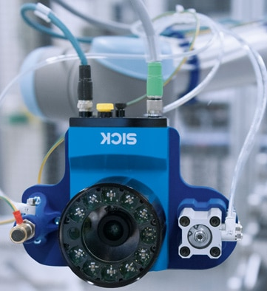
Robotics Sensing
Robotics sensing: Ideas for applicable sensors that would (1) give the robot more capability; and (2) Improve the system’s safety
An incorporated 360 degree visual sensor (illumination incorporated)
Collision detection improved
Pick and placing of ingredients can be in various places
Illumination will aid the environment as bars are poorly lit

Slide 8
Future Predictions For Robotics
Evidence-based future predictions for robotics in the given scenario

